Slide 1
IT5182: Fundamentals of Data Models and Databases
Lecture 2
Chapter 1
Database Systems

Slide 2
Objectives
The differences between data and information
What a database is
What the various types of databases are
Why they are valuable assets for decision making
The importance of database design
What the database system’s main components are
The main functions of a database management system (DBMS)

Slide 3
Introduction
Good decisions require good information derived from raw facts
Data managed most efficiently when stored in a database

Slide 4
Data vs. Information and Knowledge
Data are raw facts
Information is the result of processing raw data to reveal meaning
Information requires context to reveal meaning
Raw data must be formatted for storage, processing, and presentation
Data are the foundation of information, which in turn can lead to new knowledge

Slide 5
Data vs. Information (continued)
Data: the building blocks of information (raw facts)
e.g. a student’s name, address etc.
Information: produced by processing data
e.g. the total number of students enrolled in each course
Knowledge is the discovery of new patterns and relationships in data that allow actions to be taken
e.g. Discovering the characteristics of students who fail and taking steps to reduce this problem
Accurate, relevant, timely information is the key to good decision making
Good decision making is the key to organizational survival

Slide 6
Introducing the Database and the DBMS
Database: shared, integrated computer structure that stores a collection of data
  End-user data: raw facts of interest to the end user
  Metadata: data about data
Metadata provides description of data characteristics and relationships in data
  Complements and expands value of data
Database management system (DBMS): collection of programs
  Manage structure and control access to data

Slide 7
Role and Advantages of the DBMS
DBMS is the intermediary between the user and the database
Access database through the DBMS
DBMS enables data to be shared
DBMS integrates many users’ views of the data

Slide 8
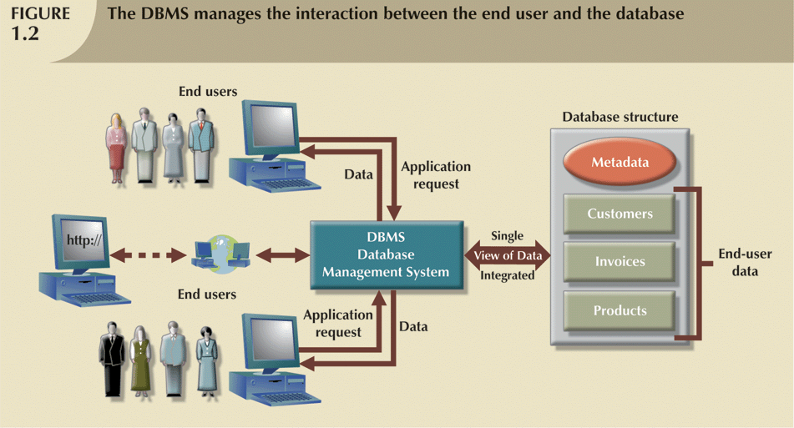

Slide 9
Role and Advantages of the DBMS (continued)
Advantages of a DBMS:
  Improved data sharing
  Improved data security
  Better data integration
  Minimized data inconsistency
  Improved data access
  Improved decision making
  Increased end-user productivity

Slide 10
Types of Databases
Databases can be classified according to:
  Number of users
  Database location(s)
  Expected type and extent of use
Single-user database supports only one user at a time
  Desktop database – single-user, runs on PC
Multiuser database supports multiple users at the same time
  Workgroup database supports a small number
  Enterprise database supports a large number

Slide 11
Data Redundancy
Organizational structure promotes storage of same data in different locations
  Islands of information
Data stored in different locations unlikely to be updated consistently
Data redundancy: same data stored unnecessarily in different places
Data inconsistency: different and conflicting versions of same data occur at different places

Slide 12
Database Systems
Database system consists of logically related data stored in a single logical data repository
  May be physically distributed among multiple storage facilities
Current generation stores data structures, relationships between structures, access paths
  Takes care of defining, storing, managing all access paths and components

Slide 13
DBMS Functions
Most functions transparent to end users
  Can only be achieved through the DBMS
Data dictionary management
  DBMS stores definitions of data elements and relationships (metadata) in a data dictionary
Data storage management
  DBMS creates and manages complex structures required for data storage

Slide 14
DBMS Functions (continued)
Data transformation and presentation
Security management
Multiuser access control
Backup and recovery management
Data integrity management

Slide 15
DBMS Functions (continued)
Database access languages and application programming interfaces
  DBMS provides access through a query language
  Structured Query Language (SQL) is the de facto query language
    Standard supported by majority of DBMS vendors

Slide 16
Summary
Data are raw facts
Information is the result of processing data to reveal its meaning
Knowledge is the discovery of new patterns and relationships in data that allow actions to be taken
Accurate, relevant, timely information is the key to good decision making
Data usually stored in a database
DBMS implements a database and manages its contents

Slide 17
Summary (continued)
Metadata is data about data
Database design defines the database structure
Databases evolved from manual and computerized file systems
  In a file system, data stored in independent files
    Each requires its own management program
  File based systems suffer from numerous problems which are largely overcome by Database systems

Slide 18
Summary (continued)
Database management systems developed to address manual file system’s inherent weaknesses
DBMS present database to end user as a single repository
  Promotes data sharing
  Eliminates islands of information
DBMS enforces data integrity, eliminates redundancy, promotes security

